Slide 1

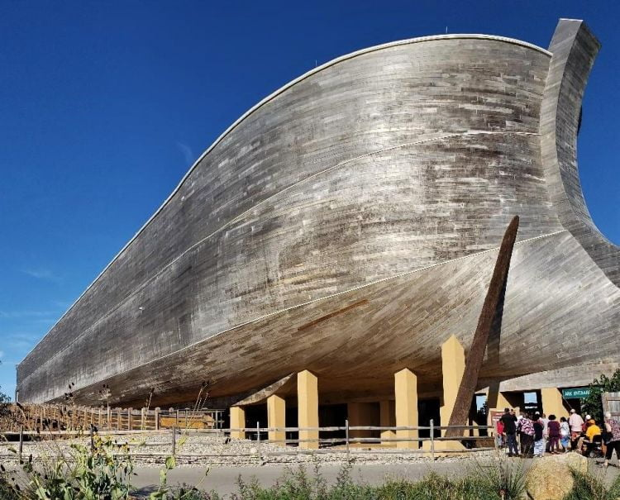
Ancient Grapes from the Land of Noah Is Noah’s Ark On A Turkish Mountain? ‘New Evidence’ Suggests Noah’s Ark Is On Mount Ararat, Turkey Or Maybe Kentucky?

Slide 2
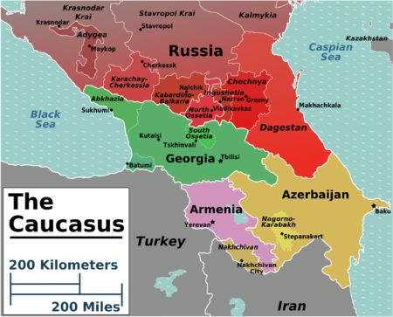
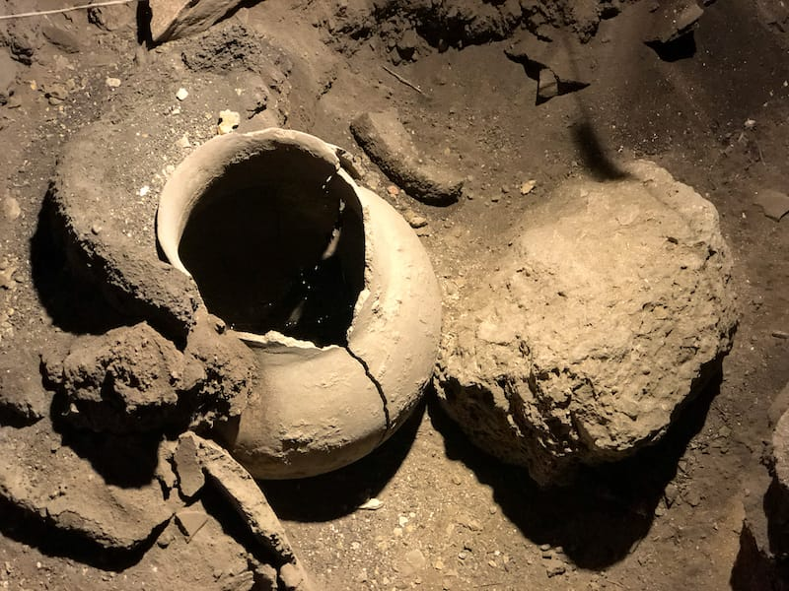
The Oldest Winery in the World
The Caucasus region encompasses the countries of Armenia, Azerbaijan, Georgia, and parts of Iran, Russia and Turkey. This region is considered to be the birthplace of wine. We know this because archeologists have discovered the oldest wine making facility in Armenia, along with grape residue in clay jars in Georgia, and signs of grape domestication in Eastern Turkey – all dating back to the time 8000 B.C. and 4100 B.C. We will be sampling wines from these 3 countries.
Around the same time as the shoe discovery, another major discovery was made- a winery! The winery was dated back 6100 years making it the oldest known winery in the world.
The archaeologists found wine-making equipment such as fermentation vats, a wine press, storage jars, and pottery sherds.
Inside the equipment were traces of the wine-making process such as remnants of grape seeds, pressed grapes, prunes, and walnuts. These bits of biological material were important in dating the winery and confirming that it was indeed used for making wine and not something else.

Slide 3
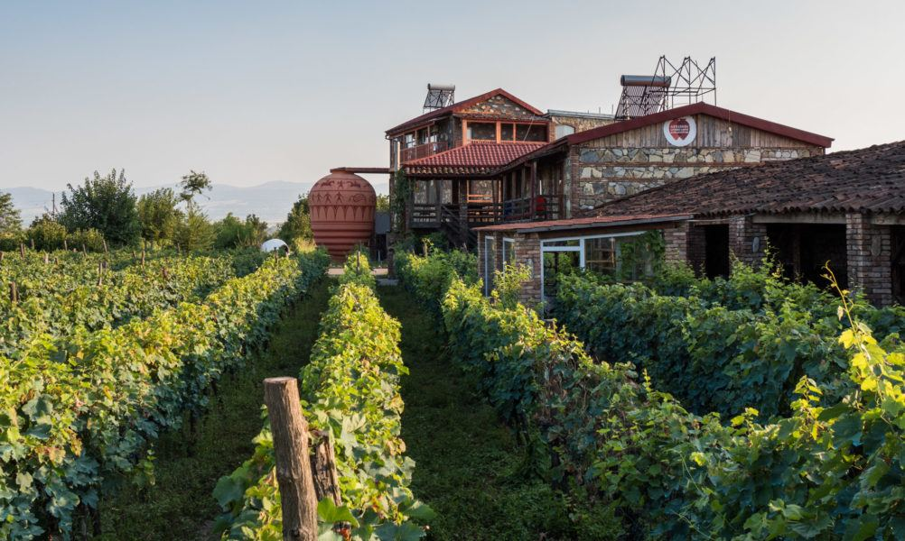
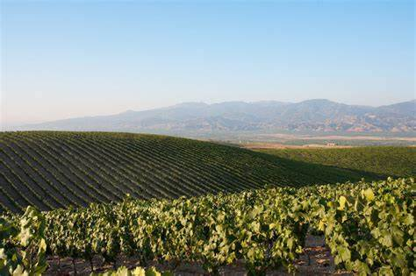
Ancient native grapes from the past for a unique wine of the present
Armenia
Georgia
Turkey

Slide 4

Stop at 1:49

Slide 5
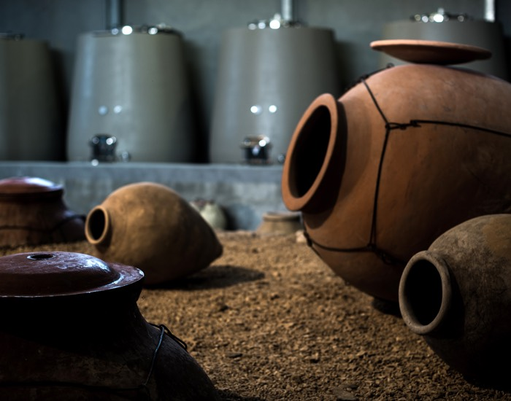

Slide 6
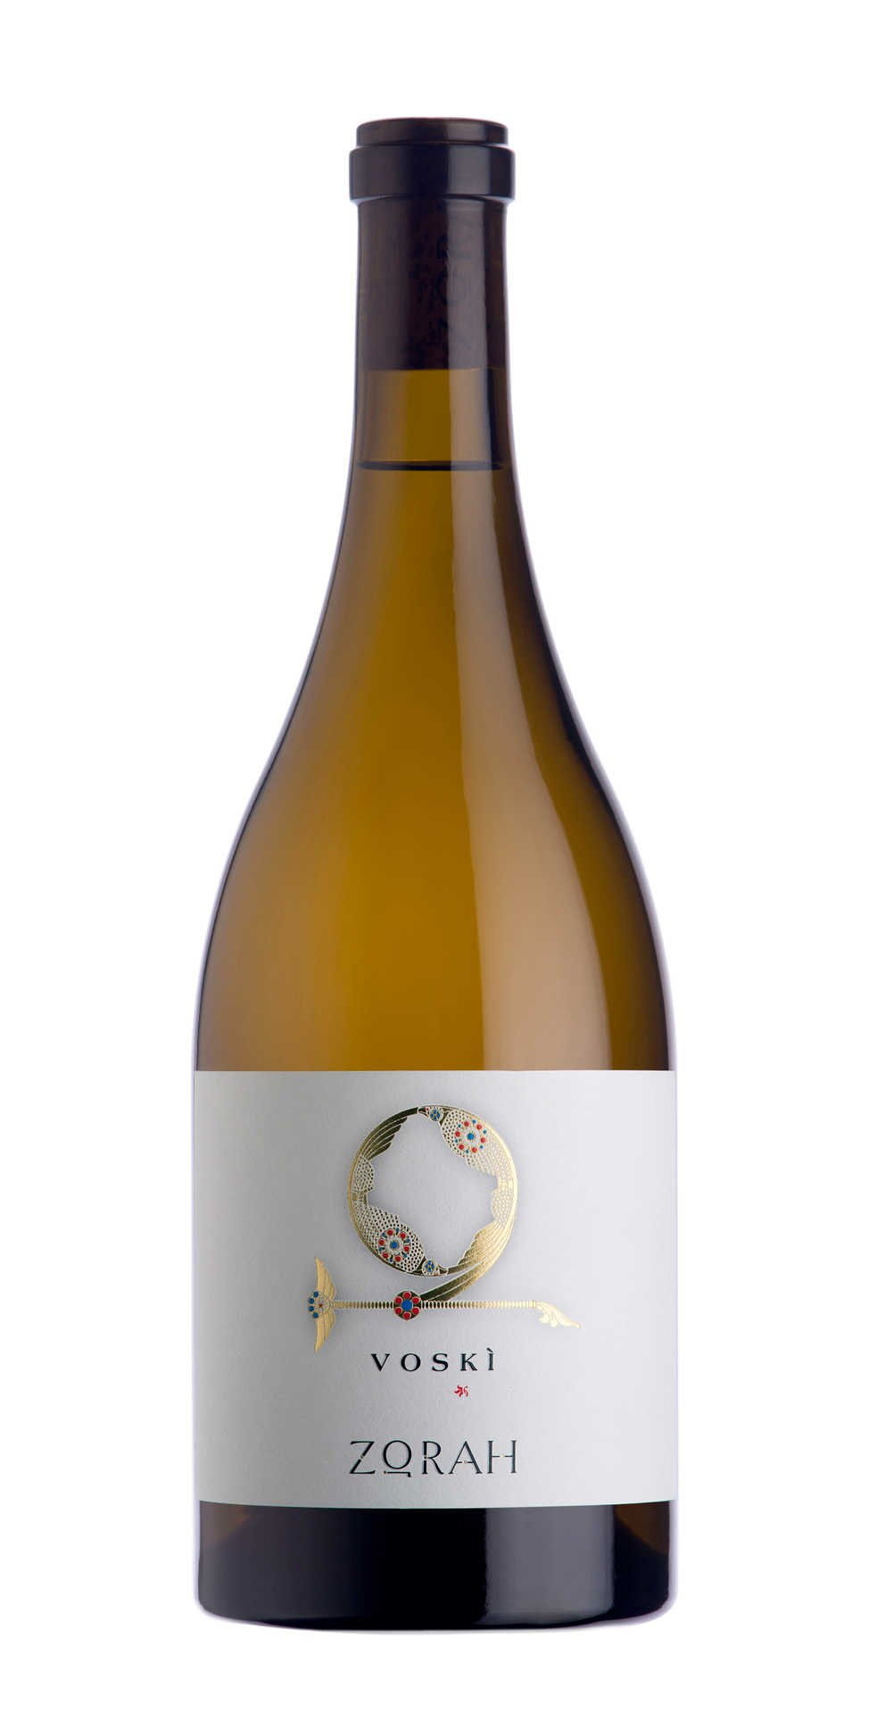
Voskì – Zorah - 2018 Voya's Dzor Region, Armenia ABV 13.5%
Voski, gold in translation, pays homage to two distinct native Armenian grape varieties which come together beautifully to create the authentic spirit of this wine. Ancient indigenous varieties, archaeological evidence suggests that both Voskèat and Garandmak, have been present in Armenia for millennia. Voskèatin translation “Golden seed” is considered Queen of Armenia’s grapes. It is a delicate golden colored grape with small compact, relatively thin-skinned berries and cross shaped bunches. Garandmak, in translation “Fatty tail”, one of the most popular grapes, is a much hardier variety, greenish yellow in color, with larger thicker-skinned berries and compact bunches.
Although both varieties are present throughout Armenia’s territory, the exceptional terroir of Vayots Dzor, with its high altitudes, low vigor Phylloxera free, rocky, sandy soils coupled with elevated daytime temperatures contrasting with the cool nights, yield distinctively balanced fruit in this region and highlight the full potential of these grapes. The grapes for Voskì are sourced from old vineyards at altitudes of 1400 meters (4500 ft) from vines grown on original ungrafted roots.
Fermentation occurs in large, temperature controlled concrete vats which are left rough deliberately to favor micro-oxygenation using only natural yeast. Aging then continues in concrete vats for eleven months with further six months in bottle. Concrete is preferred to stainless steel as they allow the wine to breath over the aging period enhancing the wine character
Vibrant, juicy and layered with beautiful acidity that comes from the high altitudes. The floral and spicy notes give way to a full-bodied white and the final blend is like a symphony on one’s pallet.

Slide 7
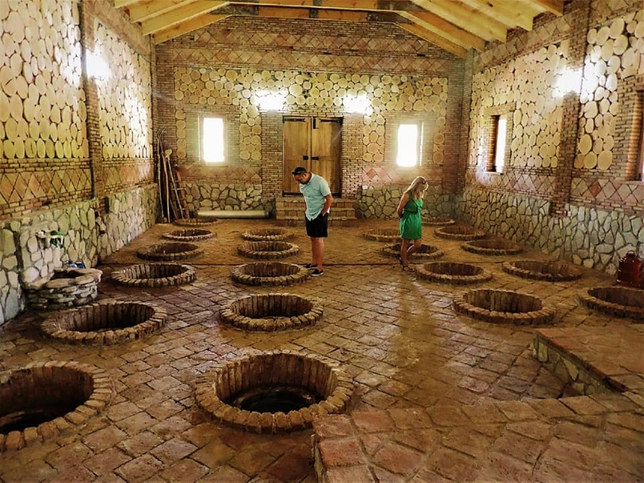

Slide 8
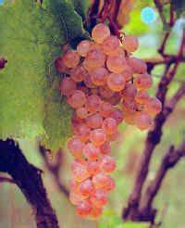
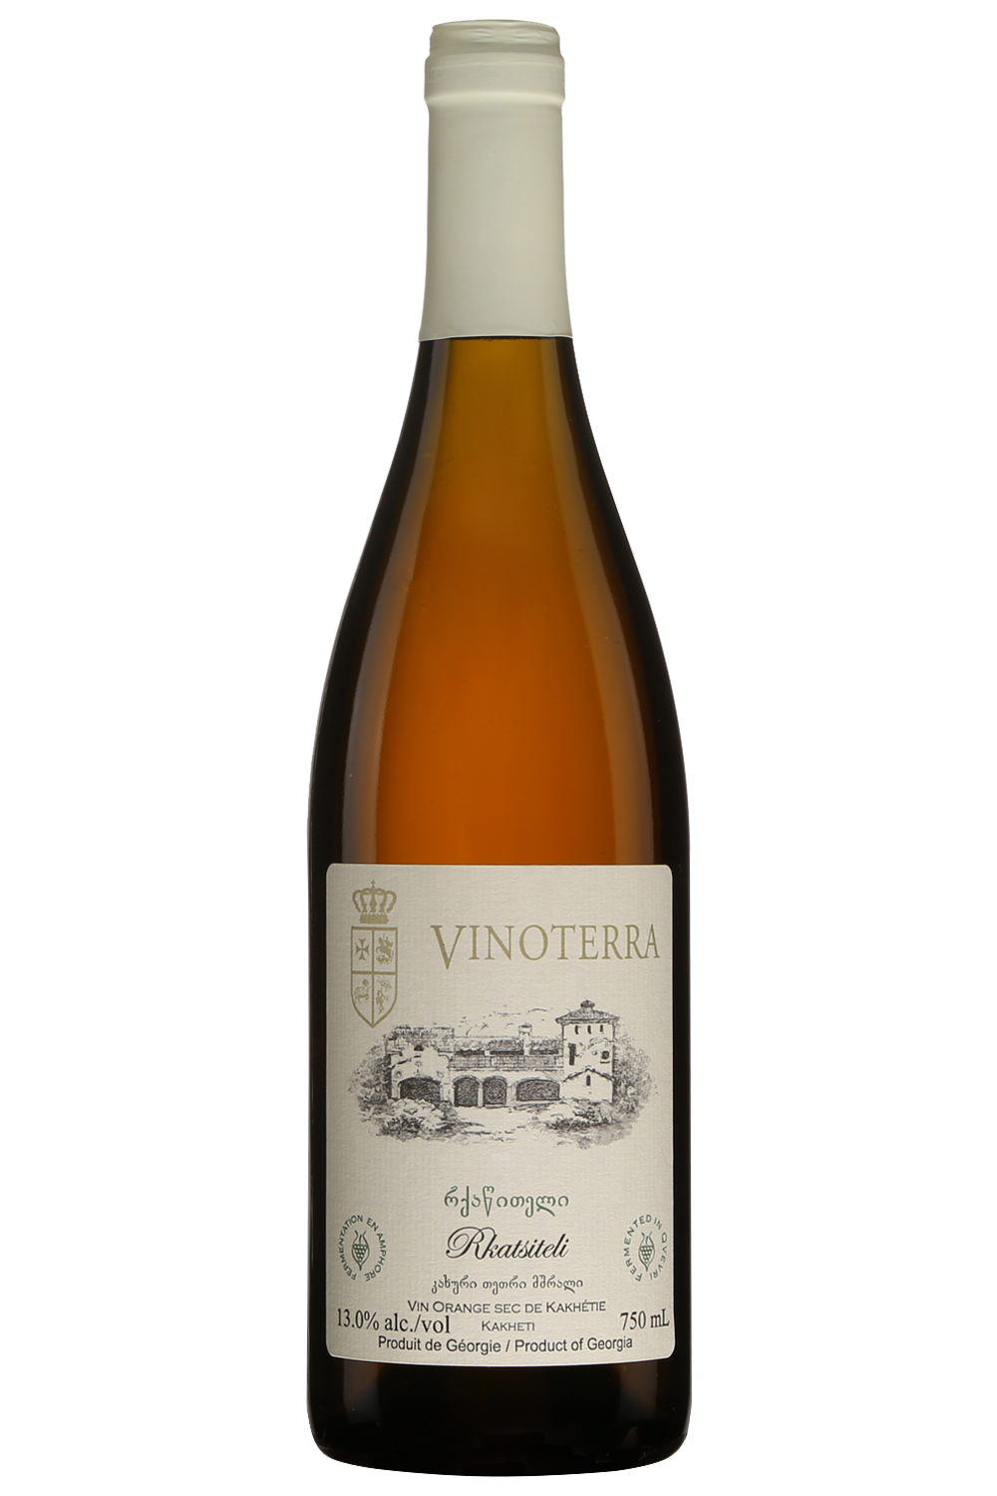
Vinoterra – Rkastsiteli – 2020 Kakheti Region, Georgia ABV 13.0%
Made from the famous Rkatsiteli (name means “red stem”) variety grown in Georgia’s Kakheti region. Rkatsiteli comprises nearly half of Georgia’s vineyard plantings. It is a hardy, easy-to-grow grape as it is resistant to cold and maintains a high level of acidity and sugar as it ripens. This distinct white wine was fermented in Qvevri (clay vessels) in the classic ancient style. This grape is one of the oldest described grape varieties from the Georgian vineyards of Kakheti. The wine is produced by a traditional method of Kakheti which means that the fermentation of the grapes for a period of 6 months takes place in a Qvevri without the addition of yeast. Due to the method, the wine cannot be characterized as a usual white wine, the color is more amber. This wine is bottled without filtration. What Chardonnay is for California, this grape is to Georgia.
This Vinoterra Rkatsiteli wine has an amber color due to the long contact with the skin in the Qvevri. It is an elegant wine with aromas of apple and pear combined with a nice touch of minerality and earthy notes. The taste is intense, with a beautiful creaminess on the palate.
The Vinoterra Rkatsiteli is a perfect intro into Georgian Amber qvevri wines. Vinoterra is now the largest qvevri producer after starting out as a family project in 2003. Wine Maker Gogi Dakishvili crafts this all-natural wine with the western pallet in mind. His qvevri wines have all of the characteristics of authentic Georgian qvevri wine but with elevated acidity and more rounded tannin.
This is a must-try wine, even if you prefer red wine.
The wine is perfect with grilled pork with a pomegranate jam, or a nice piece of grilled white fish.

Slide 9
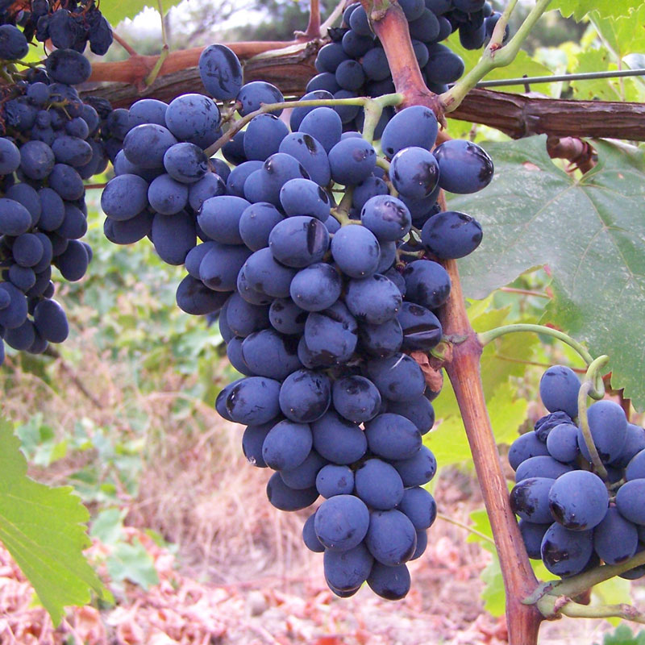
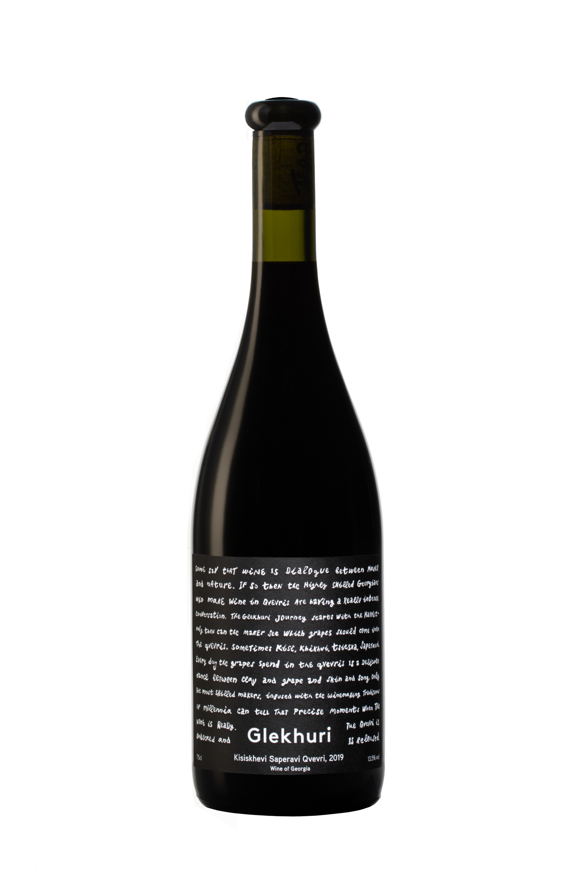
Glekhuri Kisiskhevi Saperavi - Qvevri - 2019 Teliani Valley, Georgia ABV 13.5%
Saperavi means “color/dye”. This is the most widely planted red wine variety in Georgia. This dark-skinned and dark-fleshed grape makes deep red, inky, and often opaque wine with heavy body and profound texture. Some wineries in the country label it as black wine instead of red. This dry red wine is made from Saperavi grapes grown in Kisiskhevi village, Kakheti. It is dark ruby color, with aromas of red cherry and complex and concentrated flavors of redcurrant, cranberry and blueberry, licorice, chocolate, earth, smoked meat, tobacco, savory spice, and pepper. The wine has full body, smooth tannin structure and a long aftertaste, and will age well in the bottle.
Glekhuri wines are handmade, limited production wines sourced from selected vineyards and feremented in Qvervi, large clay jars buried under ground, with minimal intervention.
Spontaneous fermentation sourced from a single vineyard in Kisiskhevi in 1300-2500L Qvevri, 2-3 weeks of skin contact in quevri, then transfer to another quevri for 6 months aging. Racked then bottled. Limited edition of 6500 bottles
This wine pairs well with mushrooms and steak.

Slide 10
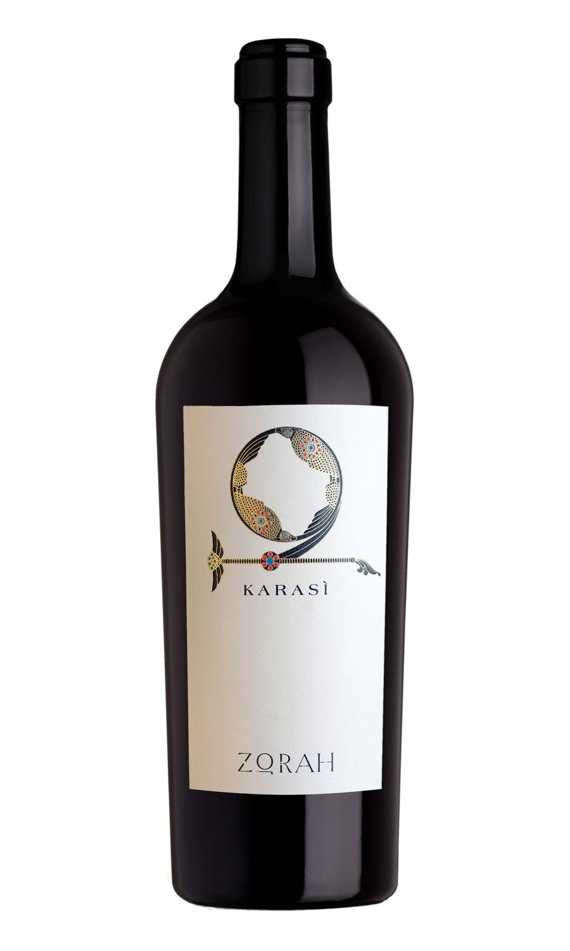
Karasì – Areni Noir - Zorah - 2017 Voya's Dzor Region, Armenia ABV 13.5%
The thrill of drinking history
Karasi is a tribute to the 6100-year wine tradition of Armenia. A wine of distinctive varietal identity with a perfect expression of the unique characteristics of its exceptional terroir, it is made solely from the indigenous Areni Noir grape in its purest form. Aged for long periods in traditional amphorae, hence its name karasi, ‘from amphorae’ in Armenian. This wine embraces the living heritage of a country while at the same time it delves back into a long-forgotten chapter in the ancient history of wine.
Nestled in the shadows of biblical Mount Ararat, at 4600 feet above sea level and only a stone’s throw away from the most ancient of sites (the 6100-year-old Areni cave considered to be the world’s oldest winery) the vineyards of Zorah are set in the rural village of Rind in Vayots Dzor, Armenia’s quintessential wine producing region.
Areni Noir is an ancient dark-skinned red grape variety native to Armenia. The grape originates from the village of Areni located in the wine-growing region of Vayots Dzor. It is one of the red wine stars of the country used to make full-bodied wines with good ageing potential in the Transcaucasia mountains. Because of geographical isolation and its harsh growing climate, it was never affected by phylloxera. Areni is a late-ripening grape with thick-skinned berries. It makes red wine with light hue, high clarity, fresh acidity, and soft tannins. Wines made from this grape can have sour cherry, herb, spice and grassy flavors – witch at times remind us of a cross between Pinot Noir and Sangiovese.

Slide 11
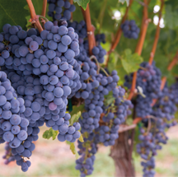
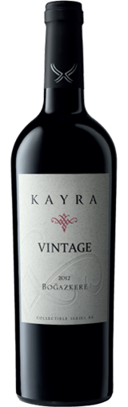
Vintage Bogazkere Diyarbakir- Kayra – 2013 Collectible Series #8 Southeast Auatolia, Turkey ABV 12.5%
Bogazkere is native to Diyarbakir area in South East Turkey. It prefers to grow in a hot, dry climate, at high altitude.
The name Bogazkere translates to “throat burner” – a possible reference to its strong tannins and medium acidity, which is reminiscent of Tannat. Bogazkere can be used as a blending grape and can also be made into a varietal wine. In varietal wine, it expresses notes of dark berry, pepper, dark chocolate, clove, eucalyptus, tobacco, and licorice.

Slide 12
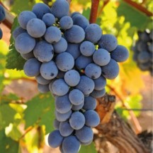
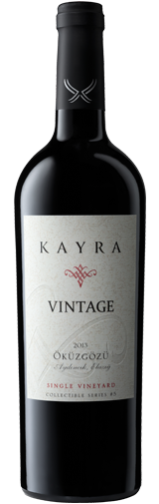
Vintage Okuzgozu Elazig Single Vineyard- Kayra – 2015 Collectible Series #5 Eastern, Turkey – ABV 15%
Okuzgozu is is native to the Elazig area in Eastern Turkey. It likes hot, dry summers, and cold winters, which matches up perfectly with the extreme continental climate of the Anatolian Plateau. The name means “ox eye”, which hints at its round and fleshy appearance.
Okuzgozu has high acidity and floral aromas. On the palate, it leans towards raspberry, plum, pomegranate, brown spice, and earthy flavors. The high acidity is what stands out the most in this grape. It is often blended with Bogazkere for added structure. On its own, it makes some memorable, fruit-forward wines.

