Slide 1
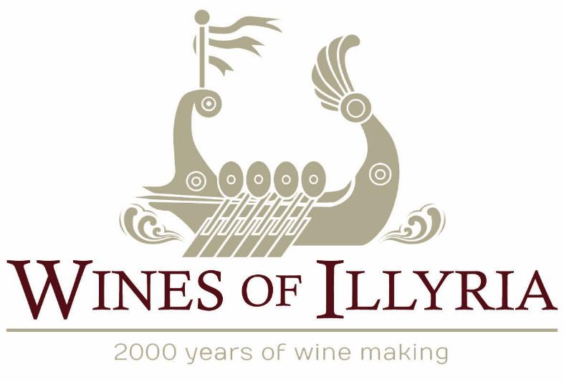
The National Tasting Project 2021 presents:
Notes:
Please Note the Following:
This PowerPoint is designed to fit a wide screen. If you use a standard screen the formatting will be skewed. (to adjust, in menu bar click on Design, then Slide size and select Widescreen)
The Wines of Illyria is the name of the distributor/sponsor we are using for wine acquisition. Illyria was the name of an ancient region on the Western Balkan Peninsula (today known as Croatia, Bosnia and Herzegovina).
The NTP is offering two regional options for wine evaluation:
Croatia
Bosnia-Herzegovina
Your chapter has the choice on how to conduct your NTP experience. You can choose to evaluate either Croatia, Bosnia-Herzegovina or both!
This PowerPoint is customizable by selecting the slides you want to use in the order you choose.
You may choose to evaluate both regions or mix it up, depending on the wines you’ve chosen. It is YOUR choice on how to proceed.

Slide 2
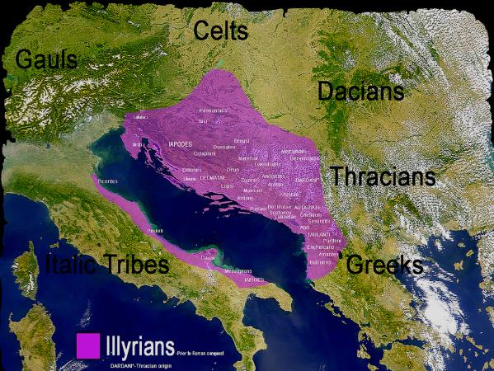
Illyria
Illyria was an ancient region originating on the Western Balkan Peninsula
Of the modern-day nations that make up the area, the NTP will be focusing on two specific countries:
Croatia
Bosnia & Herzegovina
Notes:
First and foremost, Illyria is an ancient region and Illyrians were the people who lived there.
We are going to learn specifically about the wines and grapes from Croatia and Bosnia-Herzegovina.

Slide 3

History
Winemaking (and partaking) in the Balkan Peninsula has been around since the ancient times of Illyria
Evidence of the region’s wine producing tradition can be found on medieval Stećci, fortresses and ruins decorated with motifs of grapes and goblets
Notes:
Winemaking (and partaking) in the Balkan Peninsula has been around since the ancient times of Illyria.
Evidence of the region’s wine producing tradition prior to the arrival of the Romans can be found on stećci,
Stećci - Medieval tombstones scattered across Bosnian’s mountain tops, which are decorated with motifs of grapes, vines and a very happy man waving or beckoning
Medieval fortresses and ruins decorated with motifs of grapes and goblets.

Slide 4
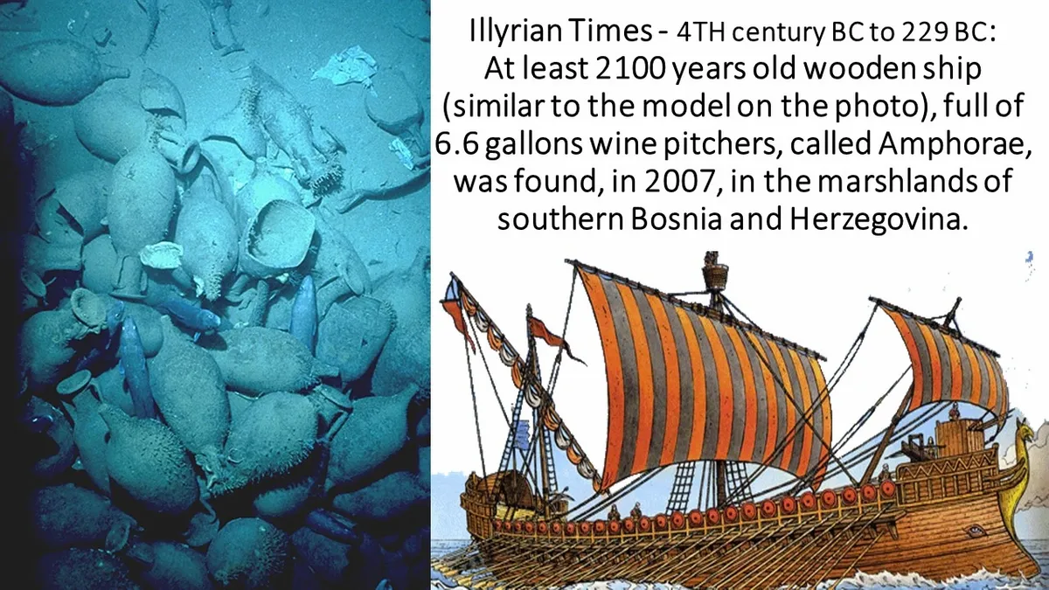
Notes:
In 2007, Archeologists discovered two Illyrian ships in the marshlands of Hutovo Blato.
The ships sank more than 2,500 years ago.
They were loaded with amphorae (clay jars) filled with Illyrian wine destined for distant ports.
Fun Fact:
Currently in Drace, Croatia a couple of bar owners decided to store their wine Mysterium made from Plavac Mali in the Bay of Mali Ston, in the Adriatic sea. Initially, they had issues with sea water leaking into the bottles and too much sunlight filtering through the water. To remedy this, they decided to use amphora. They now allow guests to join their sommelier to “Dive” for their drink! Mysterium is kept on the sea floor for about 3 years before it is sold. The wine is said to be smoother and well rounded with less alcohol and more fruit than barrel aged wine.

Slide 5
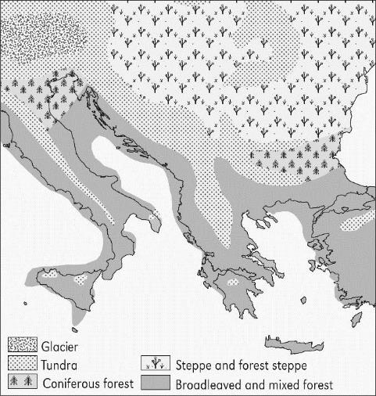
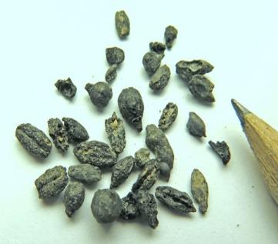
History
The Balkans were one of the few places where wine grapes naturally grew during the Ice Age.
The oldest found seeds
in the region have been
dated between 4,000
and 6,000 years old.
Notes:
The Balkans were one of the few places where wine grapes naturally grew during the Ice Age. The oldest found seeds in the region have been dated between 4,000 and 6,000 years old. (They are thought to be Muscat Blanc à Petit Grains)
Along with neighboring Greece and Italy, the Illyrian regions have the longest continuous history of viticulture in Europe. These areas existed hundreds of years before the expansion of the Roman Empire.
During the Roman period, wine production increased and became more organized.
In the 15th century vineyards went into decline with the arrival of the Turks and a dramatic cooling climatic change, referred to as the Little Ice Age. The world was affected by this Little Ice Age, which was caused by several volcanic eruptions, odd weather patterns and the advancement of glaciers. This made the seasons more cold and wet. These weather patterns did not end until the 18th century.

Slide 6


Rebirth
The Balkan Peninsula was plagued with phylloxera and wars throughout the 19th and into the 20th century. Unfortunately, many vineyards and native vines were destroyed.
In the 19th century, after annexing the Balkans, Austro-Hungarians invested heavily in wine production.
Notes:
Then, when the Turks came into town winemaking went to another standstill.
In the 19th century, after the Austro-Hungarians annexed the Balkans, they invested heavily in winemaking to produce the finest wines for the Vienna-Hapsburg court.

Slide 7

Rebirth
The Austro-Hungarians planted new vineyards and re-invigorated the old that produced the native grape varieties:
Blatina
Žilavka
Bena
Pošip
Vranac
Plavac Mali
Malvazija
Notes:
They planted new vineyards and;
Re-invigorated old vineyards producing indigenous grape varieties
Such as, Blatina, Žilavka, Bena, Pošip, Vranac, Plavac, Malvazija and others
Many of these indigenous grape varieties are the central focus of Bosnia-Herzegovina’s and Croatia’s wine production today
Vineyards/Wineries were given the title of “Imperial” by the Austro-Hungarians to indicate they grew and made quality wines for the empire
Viticulture in the region continues, with the production of quality wines of both native and international varieties.
The region’s native wines, once produced only for royal consumption (from the “Imperial wineries”), can now be enjoyed around the world by anyone looking for a taste of the Mediterranean.

Slide 8
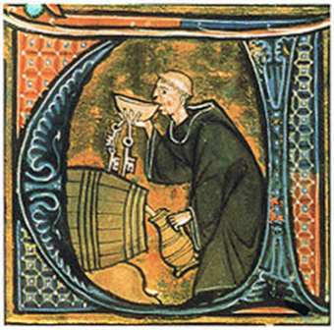
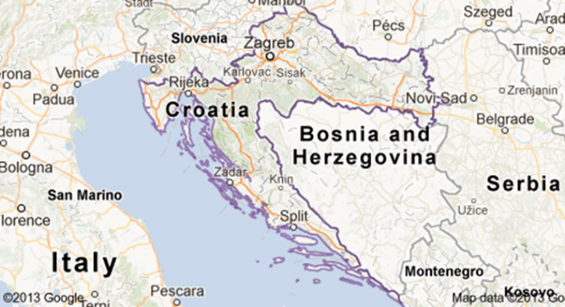
Croatia
Modern day Croatia was formed after the fall of Yugoslavia
Winemaking in Croatia predates the Roman occupation
Notes:
Croatia is a country in the east of southern Europe, formed after the collapse of Yugoslavia during the 1990s. Together with Bosnia-Herzegovina, Croatia is one of the six federal units that made up the Socialist Republic of Yugoslavia.
Croatia is in central and southeast Europe along the coast of the Adriatic Sea. It is surrounded by the Adriatic sea on the entire southwest border and Hungary, Bosnia-Herzegovina Serbia, Slovenia and Montenegro inland.
During the Middle Ages, a “Royal Wine Procurer” was the title of the one in charge of production and procurement of wine. There is a statue on the island of Korčula from 1214 that contains strict rules for protecting vineyards.
Grape growing and winemaking is not new to Croatia. The Balkan Peninsula is a stage for war and strife since the times of the Illyrians. Their most recent troubles in the 1990’s nearly destroyed all vineyards and winemaking capabilities.
Croatia has made a remarkable comeback from war with a strong Ministry of Agriculture which regulates and conducts research on wine grapes, both growing and producing. They have a strong classification system and dedicated growers, makers and tasters, but what they lack is an international marketing presence or the ability to fully commercialize and export.
Most Croatian wine is white, then red and only a small percentage of rose is made.
Locals often dilute their wine with still or sparking water –
white wine and carbonated water = gemist
red wine and still water = brevanda
Most popular and well-known Croatian native winemaker – Mike Grgich (also owns Grgich Hills Estate in Napa) – won 1976 French Classic with Plavac Mali and Posip
Dr. Carole Meredith from UC Davis helped to determine that Plavac Mali is a desendant of Zinfandel through DNA research

Slide 9
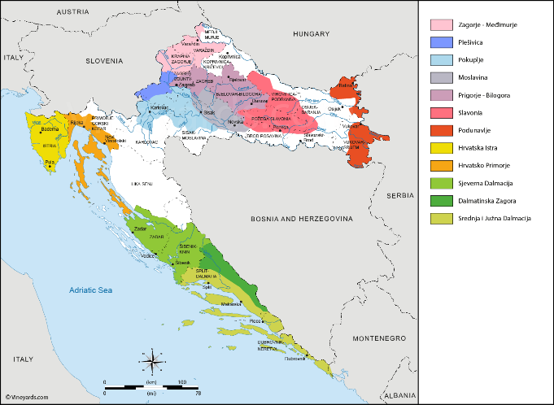
Four Major Growing Regions
Continental
Croatian Uplands
Slavonia & Danube
Coastal
Istria & Kvarner
Dalmatia
Notes:
Croatia’s four wine regions can be characterized as either continental or coastal.
Coastal: along the coastline of the Adriatic Sea (just across from Italy)
Continental: this region is located inland along the Dinnaric Alps and the Pannonian Plains
Extra credit points:
The Croatian Ministry of Agriculture has separated winemaking regions in Croatia into 4 broad regions, and then divided those 4 up to even smaller winemaking regions. There are currently over 300 geographically defined wine regions and a strict classification system to ensure quality and origin.
Those regions are designated as “Zaštićena oznaka izvornosti” – abbreviated to ZOI. (We can recognize this designation as a “Protected Designation of Origin” (PDO) used by the European Union)
The ZOI offers protection and designation of a region with specific and detailed boundaries
The ZOI on a label indicates that the characteristics and quality of a wine is the product of the specific geographical region where the grapes are grown, and of a regulated winemaking process
The ZOI also limits the grape varieties that can be protected in the region. (what grapes in each region that can be grown and used in wine production, etc.)
You can also find the following classifications:
Vrhunsko vino s kontroliranim zemljopisnim podrijetlom = Premium wine with controlled geographic origin
Mlado vino = young wine
Arhivsko vino = archive wine (cellared for 5yrs, min 3 yrs in bottle)
Suho = Dry
Polusho = Semi-dry
Slatko = Sweet
Bijelo = White
Crno = Red (Black)
Rosa = Rose
Prosek = Dessert wine from dried grapes

Slide 10
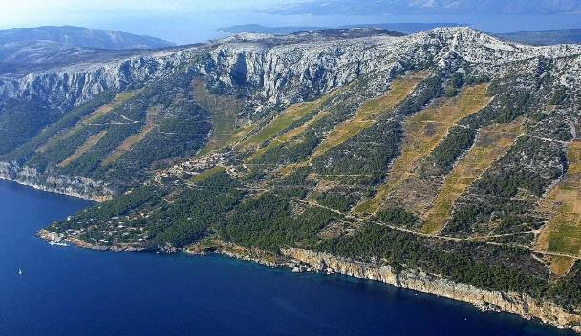
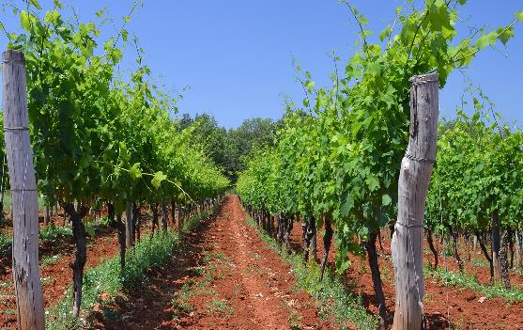
Coastal Region Istrian & Kvarner
Climate: Cold of Alps meets warmth of Mediterranean makes a cooler climate = longer growing season
Soil: Sedimentary Istrian rock and clay
Grapes: Malvazija (white) & Teran (red)
Notes:
Coastal
Istrian & Kvarner:
Climate: warmth of Med., meets cold of Alps - cooler climate = longer growing season, Geology: Karst on hillsides
Soil divided into:
Red Istria, is rich in iron oxides making it red soil is located closest to the sea
Grey Istria, sedimentary rock and grey clay located in the central peninsula
White Istria, rocky sedimentary with more limestone located at higher altitudes.
Grapes: Malvazija (white) and Teran (red) –
focus on dry fruity white – similar to Italian wines

Slide 11
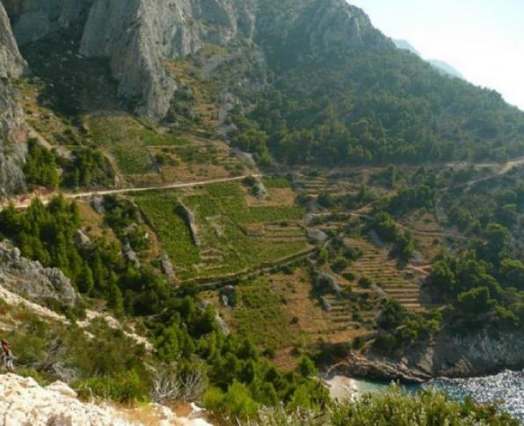
Coastal Region Dalmatia
Mediterranean climate hits a rock wall, sunny, hot, humid summers, mild winters, little rainfall
Harsh steep rocky karst formations form many microclimates
Grapes: Plavac Mali, Pošip
Notes:
Dalmatian coast: contains hundreds of islands
Climate: Hot and dry Mediterranean lots of microclimates
Soil: rocky karst (limestone), steep and harsh, well drained
Grapes: Pošip (white) and Plavac Mali (red)
Interestingly, the majority of Croatia’s red wine is produced along the coast
All of our Croatian wines for evaluation/tasting come from this region.

Slide 12
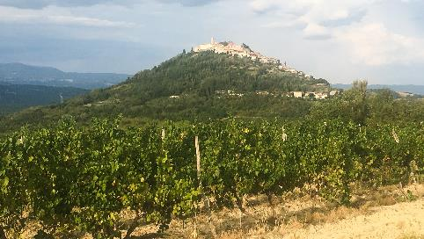
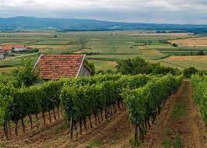
Continental Region Croatian Uplands, Slavonia & Danube
Croatian Uplands
Located in the hills surrounding Zagreb
Cool continental climate
Grapes: Pušipel (Furmint), Škrlet, Rizling Rajnski (Riesling), Pinot Noir and Purtugizec (Blauer Portugieser)
Slavonia
Continental climate
Known for its ice wine and Oak Barrels
Grapes: Frankova (Blaufränksich), Graševina,
Traminac (Gewürztraminer)
Notes:
The Croatian Uplands Region is the coldest wine growing region in Croatia. It surrounds the capital city of Zagreb. The topography is surrounded by rolling hills and small family-owned wineries. Native and international grapes are grown here, the cool climate intensifying the aromas and giving high acidity to the wines. The hills allow full sun exposure and the winds aid in ripening the grapes and prolong the growing season.
White:
Pušipel (Furmint) is made in dry and noble rot sweet styles
Škrlet is made in the east of region and is similar to Grüner Veltliner
Rizling Rajnski (Riesling), Pinot Blanc, Sauvignon Blanc, Chardonnay
Red:
Pinot Noir
Purtugizec (Blauer Portugieser)
The Slavonia Region is an area of plains and golden wheat fields surrounded by three rivers (Danube, Drava and Sava). Graševina is the main white grape here, with the best examples coming from the low hills in the Kutjevo appellation. Along the eastern border of the Danube river Taminac (Gewürztraminer) is popular, along with Frankovka (Blaufränkisch). Slovanian Oak is highly regarded and used for some of the finest wines in the world.
The Continental Climate with warm summers and cold winters, and Loess water permeable soils gives the whites here rich, floral tones and the reds sweet, fruity vibrancy.

Slide 13
Major Croatian Grapes
Pošip (white)
Originated on the island of Korčula along the Croatian coast
Has been cultivated on mainland Croatia since the 60’s
Plavac Mali (red)
Croatian
Cross between Crljenak Kaštelanski (Tribidrag/Zinfandel) & Dobričić
Grown almost exclusively in the Dalmatia region
Produces rich high alcohol wines
Other major varieties include:
Tribidrag, Graševina
Notes:
Plavac Mali has small blue grapes, high in grape tannins and again high in sugars and acids. Can have up to 17% alcohol. Wines can be dry and semi dry
Appearance:
Aroma: Blackberry, pepper, black cherry, spice
Plavac Mali Fun Fact:
Was once thought to be the ancestor of Zinfandel.
In 1998, Dr. Carole Meredith at UC Davis discovered that Zinfandel (Croatians call it Tribidrag) is actually one of the parents of Plavac Mali.

Slide 14
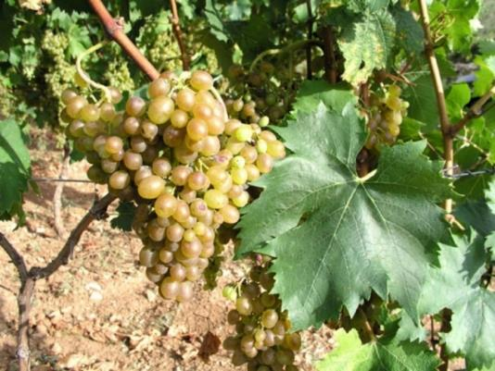
Pošip
(Poh-ship)
White wine grape grown mostly in the Dalmatia region.
Appearance: medium to golden straw
Aromas: citrus fruits, peach, apricots, figs, vanilla, almonds, crisp green apples
Overall: fresh vibrant wines that are typically light-bodied yet have a viscous weight in the glass (think Viognier)
Notes:
Used to only grow on one island (Korčula) in Croatia but is now also grown in Dalmatia. Tend to be full-bodied with crisp apples, citrus, vanilla and almonds
It comes from two lesser know varieties that grow only on the island of Korčula. (Bratkovina Bijela and Zlatarska Bistrica) that can trace its history to 1864.
Now, mainly grown in Dalmatia
Grape is an early ripener, with good acids. It is relatively high in alcohol 12 -14%
Appearance: medium to golden straw
Aromas: Citrus fruits, peach, apricots, figs, vanilla, almonds, crisp green apples
Overall: fresh vibrant wines that are typically light-bodied yet have a viscous weight in the glass
Famous for Mike Grgich (winner from the Judgement of Paris in 1976). He returned to Croatia in the mid-90’s and has dedicated himself to making wines from Dalmatian grapes, mainly Pošip and Plavac Mali.

Slide 15
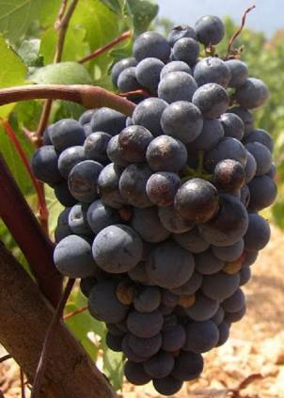
Plavac Mali
(Plah–vats Mah–lee)
Plavac Mali is the primary red grape of Croatia, it grows along the Dalmatian Coast.
Appearance: medium to dark ruby
Aromas: blackberry, figs, spice, black cherry, pepper
Overall: produces a highly alcoholic and tannic wine with lower acidity, but rich and full of flavor
Notes:
Plavac Mali is the primary red wine of Croatia and grows mostly along the Dalmatian coast. It is a cross of ancestral Zinfandel and Dobričić.
Often grown as a bush in rocky steep slopes.
Higher in alcohol and tannin with lower acidity
Specs: up to 17% alcohol
Plavac Mali so important in Croatia that it was the first to have its own appellations – Dingač and Postup, which are both located on the Pelješac peninsula in South-Central Dalmatia.

Slide 16
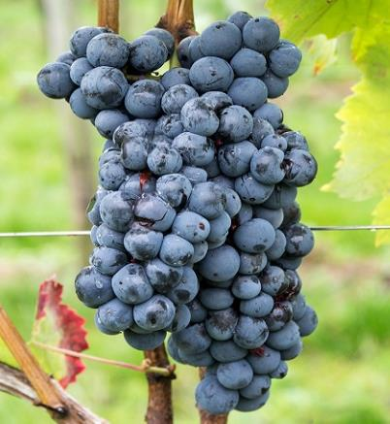
Tribidrag
Also known as Primitivo, Zinfandel, etc.
Appearance: dark red ruby to purple
Aroma: ripe red berries, raspberry, blackberry, pepper, currants, raspberry, cherry, plum, spices
Overall: robust red wines with high alcohols
Notes:
Zinfandel was known as the Croatian grape, Tribidrag, since the 15th century. Determined though DNA work of Dr. Carole Meredith and team at UC Davis and Mike Grgich.

Slide 17
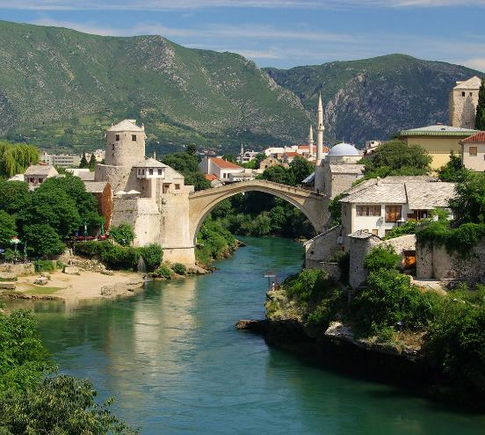
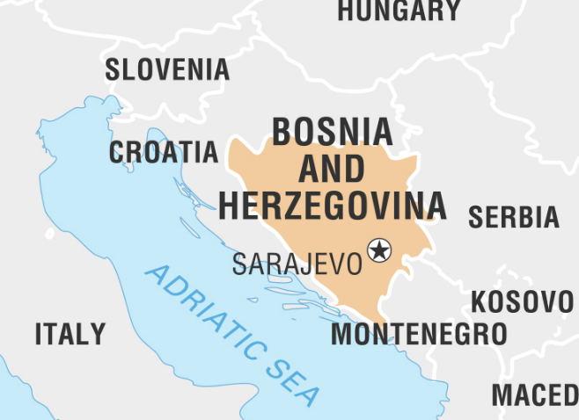
Bosnia-Herzegovina
Notes:
Bosnia-Herzegovina (BiH) is a Federation located in the east of southern Europe.
Together with Croatia, it is one of the six federal units that made up the Socialist Republic of Yugoslavia and was formed after the collapse of Yugoslavia in the 1990’s.
Grape growing and winemaking is not new to BiH, but the Balkan Peninsula has been a stage for war and strife since the times of the Illyrians (over 2000 years ago). Their most recent troubles in the 1990’s nearly destroyed all vineyards and winemaking capabilities.
Winemaking in Bosnia-Herzegovina has a long history, but little commercialization abilities, international marketing or export capabilities.
The area is ripe for growth and within the past 10 years, many pioneers have begun taking the steps needed to commercialize. The potential for quality wine production is high.

Slide 18
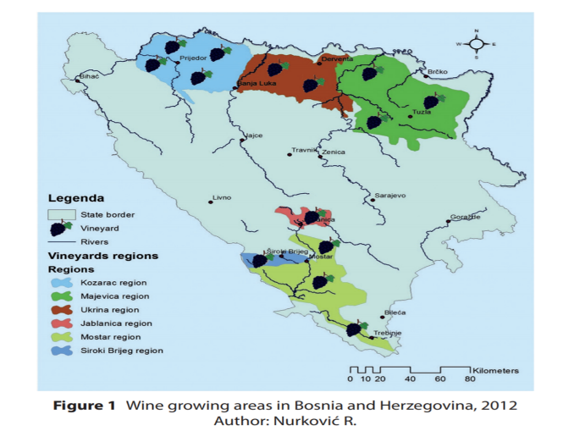
Major Growing Regions
Northern Bosnia:
Kozarac Region
Ukrina Region
Majevica Region
Herzegovina:
Siroki Brijeg Region
Mostar Region (most popular)
Jablanica Region
Notes:
BiH has two major recognized wine growing regions, Northern Bosnia and Herzegovina. Each growing region is further classified into three more specific wine regions:
Northern Bosnia: Mostly forested with Dinaric Alps in center and Pannonian Plains to the north
Kozarac Region
Ukrina Region
Majevica Region
Herzegovina: Located along the Adriatic sea south of Northern Bosnian region
Siroki Brijeg Region
Mostar Region – most important region
Jablanica Region
All of our NTP Bosnia-Herzegovina wines come from the Herzegovina Region.

Slide 19
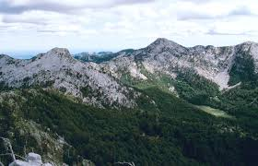
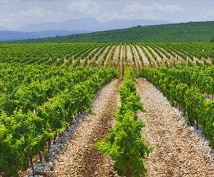
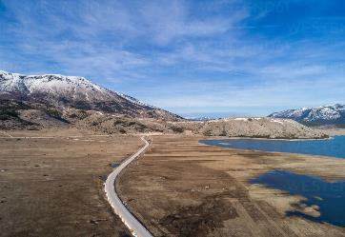
Northern Bosnia
Mostly forested with Dinaric Alps in center and Pannonian Plains to the north
Continental, warm summers, dry cold winters, sufficient rain
Soil consists mainly of limestone
Grapes: Blatina & Žilavka
Notes:
Northern Bosnia is mostly forested with the Dinaric Alps in the center and just kisses the Pannonian plains in the north.
Soils consist of limestone with deposits of iron, coal, lead, manganese, bauxite, lead and salt.
The Northern Bosnian region has continental climates of warm summers and cold snowy winters.

Slide 20
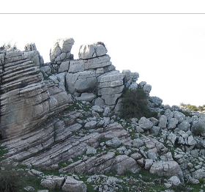
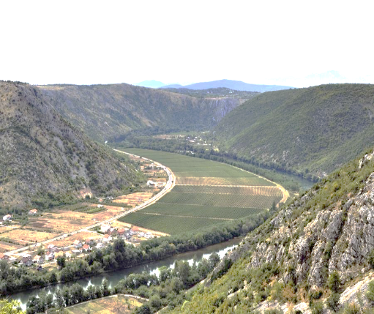
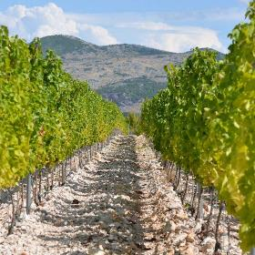
Herzegovina
Located along the Adriatic sea south and inland
Climate is dry Mediterranean, in the summer with mild winters.
Soil is rocky consisting of stony limestone soil.
Dry Mediterranean climate with mild winters
Notes:
The Herzegovina region is located along the Adriatic sea in the southern portion of the country.
Only a small part of Bosnia-Herzegovina actually touches the Adriatic sea, but it is not far away, and Herzegovina is able of enjoying a dry Mediterranean climate in the summer with cold winters.
Geology consists of karst formations (dissolution of soluble rocks – gypsum, dolomite and limestone)
Most vineyards are stoney and vines seem to rise from the limestone rock.

Slide 21
Major Grapes
Two grapes dominate Bosnia-Herzegovina wines
Žilavka (Z-lav-ka)
White wines
Žilavka is acidic and usually makes an alcoholic light-colored white wine
Blatina (Blah-tee-nah)
Red wines
Blatina is a dark red grape that results in a dry ruby red wine
Other varieties include:
Bena, Tamjanika, Trnjak, Vranac,
Cab Sauv, Merlot, Syrah, Zinfandel
Notes:
These two grapes Žilavka and Blatina were only produced and grown in the Balkans, but now are grown in Louisiana!!! Yes, Louisiana.
Just a short word here on Bena as it is used minimally as a blending grape.
Cultivated mostly in Mostar region
Unknown parentage.
Also a table grape

Slide 22
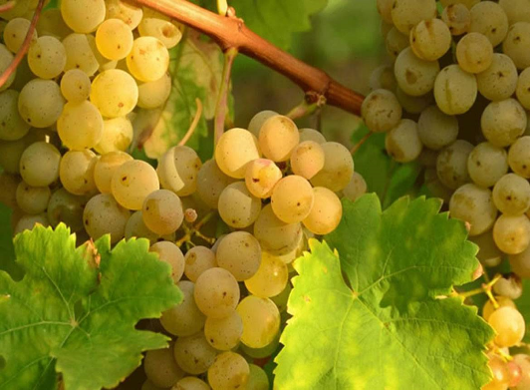
Žilavka
(Z-lav-ka)
White wine grape planted mostly in Mostar region of Herzegovina
Appearance: pale straw with slight greenish tinge
Aromas: citrus, wildflower florals, roses, herbs, and minerals (nutty in barrels)
Overall: fresh vibrant wines with bright acidity and higher alcohol
Žilavka used to be a minor blending grape but no longer!
Notes:
Has thick, but transparent skin allowing for lots of sugar and acid. One of the meaning for its name is “strong roots” as the vine roots deeply and is draught and heat resistant.
Appearance: pale straw can have a slight greenish tinge or a medium straw (when barrel aged)
Aromas: citrus, wildflower florals, roses, herbs, and minerals
Overall: creates vibrant, fresh, acidic wines with high alcohol
Specs: 12-14% alcohol 5-6 g/l Total acidity
Everybody experiences the Žilavka wine in a personal and individual way.
It has the strength of a typical southern/Mediterranean wine
Has high alcohol and acidity but gains roundness when barrel aged.

Slide 23
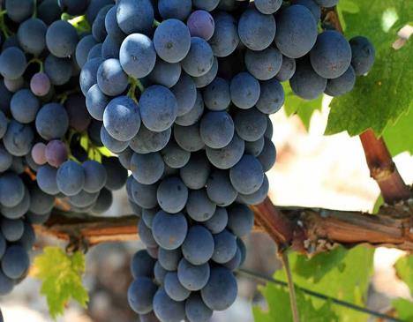
Blatina
(Blah-tee-nah)
Unique red wine grape that grows in only a small part of Herzegovnia. Grape is being kept relevant by devoted growers and winemakers.
Appearance: clear and bright ruby reds to deep purples
Aromas: bright florals, eucalyptus, tart red fruits, spice, red currant, plum
Overall: fresh dry red wine with higher alcohols, yet soft and tarty – similar to Gamay or Zweigelt
Notes:
Unique red wine grape that grows in only a small part of Herzegovinia. That is being kept relevant by devoted growers and winemakers.
Difficult to grow (only has female flowers). Usually planted along other vines for, and to assist with, pollination.
Has a flowering time of 3 days or so and must be planted with other pollinators. Some years do not produce fruit at all.
Can be aged in stainless steel and/or oak.
Appearance: Clear and bright ruby reds to deep purples.
Aromas: florals, eucalyptus, tart red underripe fruits, spice, chocolate
Overall: Lighter red wine (Gamay-ish) when grown in the south, has plenty of acid, best if aged up to 5 years in barrel.
Specs: 12 to13.5 % of alcohol 5 to7 g/l of total acidity

Slide 24
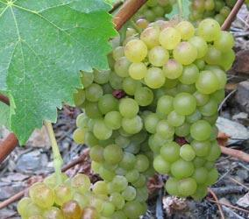
Tamjanika
Grape is a variety of Muscat Blanc à Petits Grains.
It produces light white wines.
Appearance: clear bright pale straw
Aromas: characteristic Muscat notes, floral, grapey/foxy, citrus, pineapple, sweet basil, frankincense and cinnamon
Overall: Intense aromas yet light and floral with refreshing yet tangy acidity. Drink young and fresh
Notes:
Muscat is not Muscadine.
Tamjanika is a variety of Muscat Blanc a Petits Grains.
While technically a white grape, there are strains that produce pink-reddish brown colors. One vine can produce a white grape one year and a pink one the next.
Appearance: pale to medium straw
Aromas: characteristic Muscat notes floral, grapey/foxy, citrus, pineapple, sweet basil and elderberries with touches of frankincense and cinnamon
Overall: light and floral with refreshing yet tangy acidity. Drink young and fresh.

Slide 25
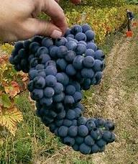
Vranac
(Vra–natz)
Kingpin grape of the Balkan Peninsula and is grown all over.
Appearance: young, wines are bright purple which turn a deep dark ruby/purple when aged
Aroma: red berry jam, pen ink, sage, cranberry, red currant, elderberry, pepper and herbs, cinnamon, chocolate, black fruit, oak
Overall: well rounded & full with medium acidity and firm tannins. Similar to Grenache. Beware, some wines can be very hot!
Notes:
Kingpin grape of Bosnia-Herzegovina and grown all over the Balkan Peninsula.
Grape is large, thick-skinned, deep color which intensifies color of wine from a young purple to an aged intense dark ruby/purply red.
Higher sugar levels than Blatina with high alcohol levels.
Appearance: Dark red to purple
Aroma: pen ink, sage, cranberry, red currant, elderberry, pepper and herbs.
Overall: If you like Grenache, you’ll like this grape. Beware, some wines can be very hot and can age nicely.
Young wines are tart, with intensive aroma, almost wild. They are tamed by aging in wooden barrels, barrique.
Well aged vranac wines are strong and full bodied.
Vintages rich in acids may produce wines suitable for years long aging.

Slide 26
Trnjak
(Ter–nyak)
Trnjak is native cultivated in Herzegovina typically planted with Blatina for pollination.
Appearance: red to dark red ruby
Aroma: black currants, raspberry, cherry, plum, herbs, spices, chalk, clove, vanilla
Overall: Trnjak is aromatic, dense and complex with upfront herbals and spices, followed by fruit
Notes:
Trnjak is a rare grape variety that is cultivated in Herzegovina
Difficult to cultivate. Growers limit the vine to one shoot to maximize flavor.
Trnjak is mainly grown together with Blatina—a grape that only has functional female flowers and needs other grape varieties to pollinate.
Often both types, Trnjak and Blatina, would be used in blends
Recently, Trnjak has been used to produce single variety wines.
Needs to be decanted for the best expression.

Slide 27
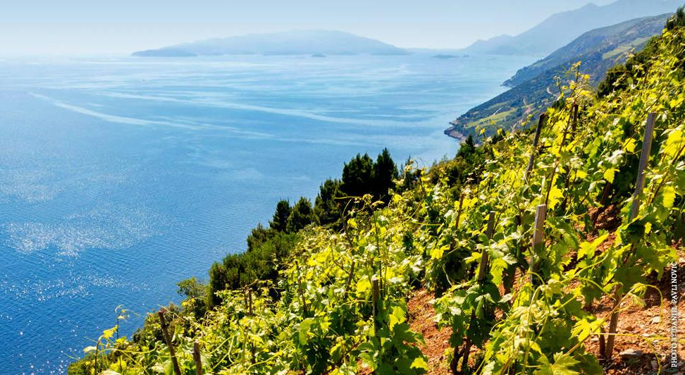
Croatia Wine List

Slide 28
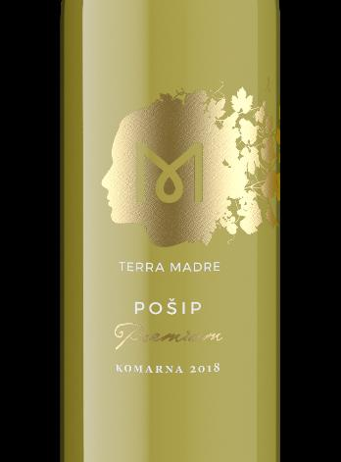
2018 Terra Madre Pošip Premium
Region: Dalmatia/Komarna
Brand: Terra Madre
Grapes: 85% Pošip, 15% Chardonnay
Alcohol: 13%
Appearance: bright straw yellow
Aromas: tropical fruits, citrus, apricots, pear, banana, mineral, figs, melon
Overall: med-bodied, moderate acidity, with mineral & salty overtones – best with food
Notes:
Pošip is the most popular white grape planted along the coast of Croatia.
This example shows bright, tropical fruits with citrus, and stone fruits, balanced with mineral and figs.
It is medium bodied and pairs well with the shellfish caught in the region.

Slide 29
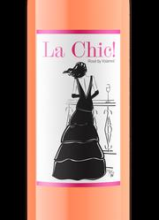
2019 Volarević Plavac Mali La Chic Rosé
Region: Dalmatia/Komarna
Brand: Volarević
Grapes: 100% Plavac Mali
Alcohol: 13.5%
Aromas: strawberry, raspberry, red fruits, citrus, lemon peel
Overall: high alcohol with robust tannins yet
fresh and fruity with good balance
Notes:
Plavac Mali has red pulp (a tenturier grape)
This gives a vibrant color and concentration to the wine, with more noticeable tannins, yet fruity and balanced.

Slide 30
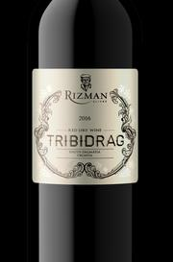
2017 Rizman Tribidrag
Region: Dalmatia
Brand: Rizman
Grapes: Tribidrag 85%, Tempranillo 15%
Alcohol: 13.5%
Appearance: deep ruby red
Aromas: plum, black tea, brambles, almond, cherry cola, sweet spice, earth and tobacco
Overall: spicy, with raspberry, and a long earthy leathery note to finish
Similar to: Zinfandel!
Notes:
The Original Zinfandel!
Region: Dalmatia
Appellation: Komorna
Vineyard: Rizman
Vintage 2016
Varietal: Tribidrag/Zinfandel
Grapes picked by hand. Aged in French and American oak 8-10 months
Aged at least 6 month in bottle before release to market
Pairs with rich stews/gravies, red meats and cheese

Slide 31
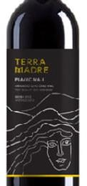
2016 Terra Madre Plavac Mali Premium
Region: Dalmatia/Komarna
Brand: Terra Madre
Grapes: Plavac Mali, Syrah, Cabernet Sauvignon
Alcohol: 14%
Aromas: figs, dried apricots, vanilla, raisined fruits, cranberry, smoky vanilla
Overall: concentrated and rich with fruit and spice
Notes:
2016 Won Silver Decanter Award in 2018
Aged for 14 months in barrels
Pair with game meat, prosciutto

Slide 32
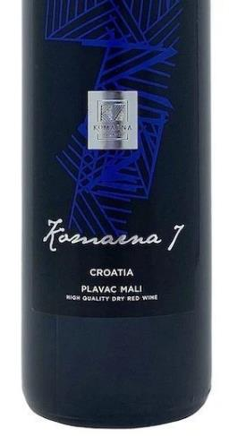
2016 Komarna 7 (K7) Plavac Mali
Region: Dalmatia/Komarna
Brand: K7 (Komarna 7)
Grapes: 100% Plavac Mali
Alcohol: 14.5%
Appearance: medium red
Aromas: black fruits, spice, plum, blackberry, pepper, dark chocolate, fig, tobacco, vanilla
Overall: moderate silky tannins, rich plum & berry with a subtle spice, decant for at least 30 min
Notes:
Only available in the USA
Certified Organic
Blended wine made from Plavac Mali from the 7 wineries located in Komarna. Each winery produced their own Plavac Mali, then sent wine to Volarevic winery to be blended.
Aged 2 years in Croatian, American and French oak

Slide 33
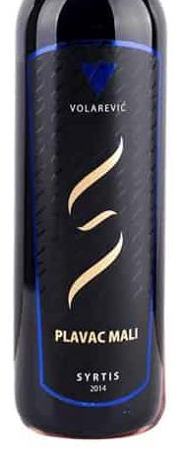
2015 Volarević Plavac Mali Syrtis
Region: Dalmatia
Brand: Volarević Winery
Grapes: 100% Plavac Mali
Alcohol: 14%
Appearance: rich red
Aromas: blackberry, blueberry, herbs, cola, chocolate, leather, cherry, cranberry
Overall: full-bodied, black plum, hints of cranberry and clove, nice balance
Notes:
100% Plavac Mali
This rich wine has concentrated dark fruit and berry flavors and aromas, with hints of chocolate and leather from integrated oak ageing.
It is full bodied with a beautiful balance, finishing with a touch of cloves and cranberries.

Slide 34
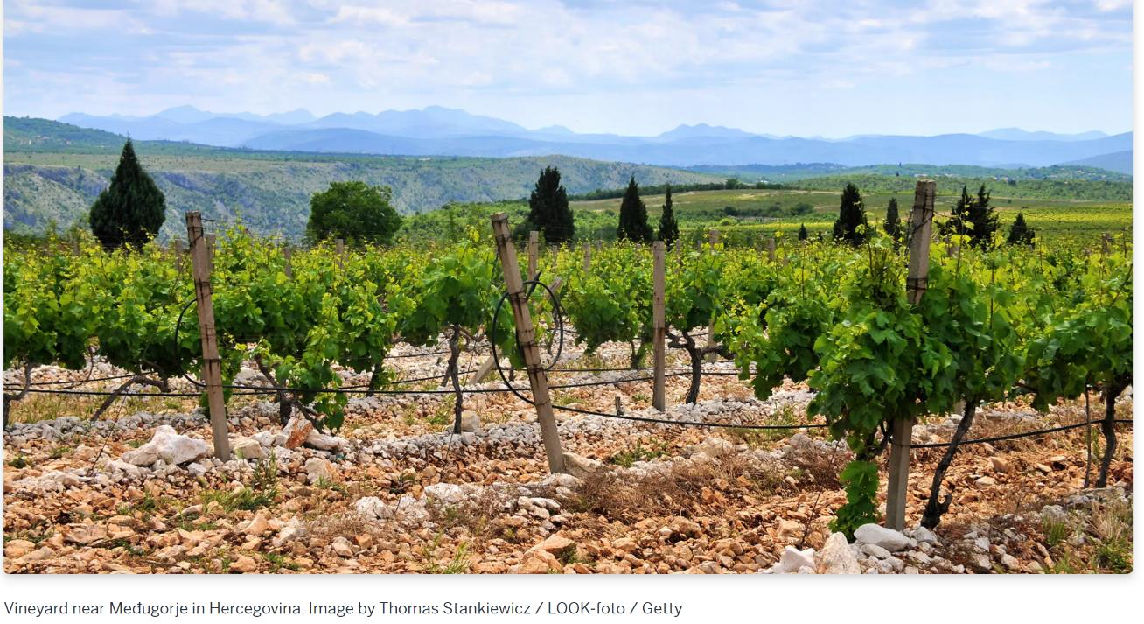
Bosnia-Herzegovina Wine List

Slide 35
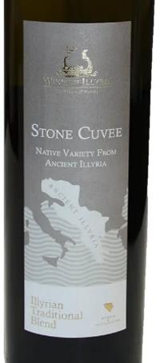
2019 Stone Cuvee
Region: Bosnia-Herzegovina
Brand: Wines of Illyria
Grapes: Žilavka 90%, Bena 10%
Alcohol: 13%
Appearance: clear, bright, reflective, light yellowish-green
Aromas: green apples, lychee, pineapple, honey, chamomile, minerals, apricots
Overall: clean & refreshing, apricot, minerals, with herbal finish
Similar to: White Burgundy from Meursault region
Notes:
90% ŽILAVKA (Zhi-LAV-kuh) and 10% BENA (BEN-na),
Both indigenous grapes
Herzegovina region
Clean and refreshing, expressing elegance and flavors of green apples, lychee and honey, scents of chamomile and verbena with a slight mineral and nutty tone
The ripe, warm flavors of apricot, star fruit and a hint of anise are coddled by juicy acidity, fine minerality and a long herbal-toned finish
Best paired with light white meat dishes and seafood, marsala chicken, fried foods

Slide 36
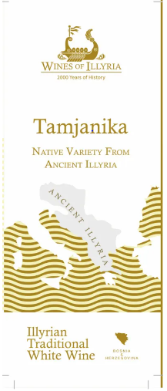
2019 Vukoje Tamjanika (Tam-yan-eeka)
Region: Herzegovina
Brand: Wines of Illyria
Grapes: Tamjanika 100%
Alcohol: 12.7%
Appearance: clear, bright, reflective, light yellowish-green
Aromas: green apples, lime peel, citrus, stone fruit, honey, chamomile, minerals, apricots
Overall: clean and refreshing, apricot, citrus, minerals, with an herbal finish
Notes:
Vukoje Vineyards produces limited, yet premium wines, they use modern technology and their “barriques”, barrels, are kept in underground cellars.
100% Tamjanika (TAM-yan-eeka),
a native variety
Herzegovina (Her-tsuh-GOH-vee­nuh) wine region
Elegant, floral and refreshing, with candied citrus and lime peel on the nose, it displays vibrant acidity with good mineral structure.
Boasting flavors of Mediterranean stone fruits, citrus, herbs and orange peel,
Pair with salads, white meat dishes, fresh water fish and seafood

Slide 37
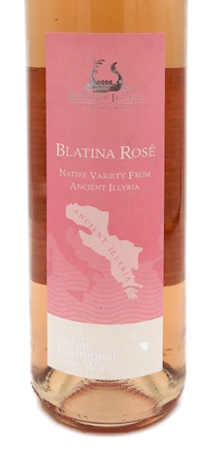
2019 Blatina Rose
Region: Herzegovina
Brand: Wines of Illyria
Grapes: Blatina 100%
Alcohol: 13%
Appearance: dark pink
Aromas: strawberry, citrus, apricot, peach
Overall: clean and deep with red berries and stone fruit
Notes:
100%Blatina (BLAH-tee-nah) grapes
native variety
Herzegovina wine region
Dark pink color
subtle tastes of wild strawberry, citrus, and underlying notes of Mediterranean stone fruits: peaches and apricots
Pair with light fish and vegetable dishes Indira’s recommendation: Cesar Salad with grilled shrimp or octopus brings wild strawberry and other red berries flavors out.
Sustainable production - to retain freshness and acidity, grapes are handpicked at dawn from the southern part of the Imperial Vineyards, 15 to 20 days before the main harvest
Made by spontaneous fermentation in a stainless-steel tank, with just a few hours of maceration, the wine is aged in a bottle for 4 months before served

Slide 38
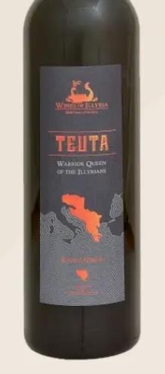
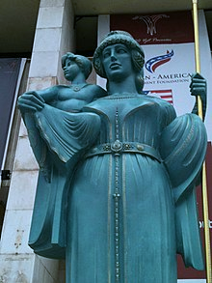
2016 Teuta Warrior Queen (Tay-ooh-ta)
Region: Herzegovina
Brand: Wines of Illyria
Grapes: Blatina 100%
Alcohol: 13%
Appearance: dark ruby red
Aromas: blueberry, vanilla, almonds, plums, chocolate, black berry
Overall: vibrant with grippy tannins with great berry flavors and a soft mocha finish
Notes:
Wines of Illyria named their barique version of Blatina after Teuta, Warrior Queen of the Illyrians
100% Blatina
Native variety the only variety that does not self-pollinate; it only has a female flower. It requires Trnjak (TER-nyak) variety planted next to it for cross pollination
Herzegovina wine region
In this wine, vanilla, blueberry and sweet marzipan aromas are revealed
Supporting the juicy acidity are flavors of blackberry and cream, red plum, black currant and mulberry
A fresh and vibrant wine with a soft chocolate-mocha character on the finish
Pair with chicken sausage paella made with red peppers and onions, white wine and butter sauce
Note: The young wine is stored in brand new small 225-liter Bosnian, French and American oak barrels to mature for 2 to 2.5 years, after which the wine is matured in bottles for another 6 months.

Slide 39
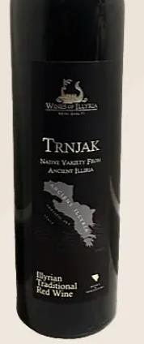
2015 Trnjak (Ter-nvak)
Region: Herzegovina
Brand: Wines of Illyria
Grapes: Trnjak 100%
Alcohol: 13.5%
Appearance: ruby red
Aromas: raspberry, cherry, plum, currant, vanilla and cinnamon
Overall: bold and herbal with lots of spice
Notes:
Vrhunsko Quality
VEGAN WINE = wine is filtered with clay
Trnjak is an indigenous grape variety
Herzegovina wine region
This bold, but elegant full bodied, wine has lots of herbal notes and abundance of spices
On a palate one can taste clove, vanilla and cinnamon, ripe aromas of currant, raspberry, cherry and plum jam.
Pair it with spicy cheeses, grilled lamb, beef stews, steaks.
Vegan wine
Interesting fact:
Trnjak is best known for being Blatina’s pollinator, as both varieties bloom at the same time
Pairs with spicy cheese, lamb, beef stew

Slide 40
2016 Deep Red Cuvee
Region: Herzegovina
Brand: Wines of Illyria
Grapes: Trnjak 100%
Alcohol: 13.5%
Appearance: deep ruby red
Aromas: plums, blackberry, dark cherry, vanilla
Overall: integrated tannins, with long finish. It is recommended to decant for at least 40 min
Notes:
Blend of the five best red varieties that grow in Herzegovina
Cabernet Sauvignon, Merlot, Syrah, Trnjak and Vranac
Grapes from Carski Vineyards along coast, lots of river rock and perfect microclimate. - similar to Chateauneuf-du-Pape
Deep ruby color, notes of ripe plums, forest berries and vanilla, will awaken all your senses
Tannins are perfectly integrated with alcohol and acidity and give complex wine whose taste lingers in a mouth for a long time
Perfect for long aging
Pair it with steak, veil, game and picante aged cheeses
Decant for at least 40 min

Slide 41
Thank you for Supporting The National Tasting Project 2021
Notes:
Please be sure to fill out the Survey Form located in your excel packet. We hope all enjoyed this presentation! Thank you for supporting
The National Tasting Project 2021
The 2021 NTP Committee members: Dave Barber, Melissa Bartlett, Joe Broski, Pam Davey, Joanne Degaglia, Eric Feldake, Sharyn Kervyn, Danny Klein, Sharon Levine, Larry Levine, Aaron Mandel, Chris McCutcheon, Roger Oliva, Semerita Oliva, Gary Pavlis, Walt Rachele, Diane Rone, Adrienne Turner, Bob Turner, Pat Valas, Vince Williams, and Khadija Woods.
PowerPoint: Melissa Bartlett
Reporting Form: Chris McCutcheon
Chair: Sharyn Kervyn

