Slide 1
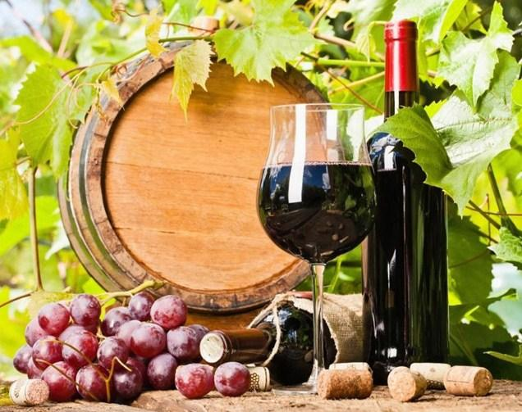
Pinot
Noir
Price vs. Palate

Slide 2
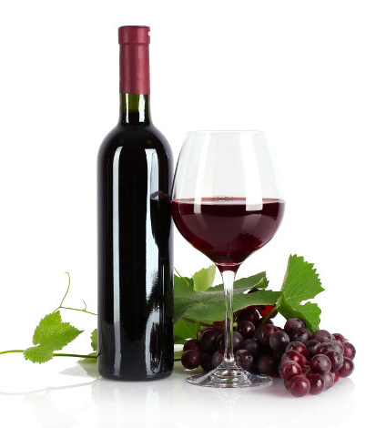
What Matters More? Price or Palate?
6 different wines
3 different regions
There is at least a $10 difference in price between each wine (per region)
Can you guess which wine is pricier? Does your palate agree?

Slide 3
Pinot Noir
Pinot Noir was born in the Burgundy region of France, and it’s in Burgundy where the best Pinot Noir is still produced.
Pinot Noir producers in France do not refer to their Pinot Noir as Pinot Noir, but instead call it Red Burgundy, after the region where it’s made.
These wines have flavors of ripe red berries, sweet black cherries, mushrooms and what Sommeliers call forest floor, that smell you get from freshly fallen damp leaves.

Slide 4
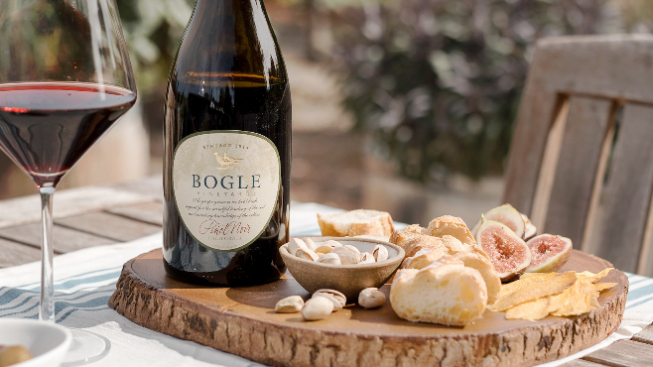
Pinot Noir can be quite expensive.
Due to the priciness of most Pinot Noirs, over the past century, producers around the world began to try growing the grapes.
Today, great and affordable Pinot Noir can also be found in California, Oregon, Australia, Chile and New Zealand.
Pinots from these regions tend to be bigger and richer in flavor, tasting fruitier than the Pinots from France.

Slide 5
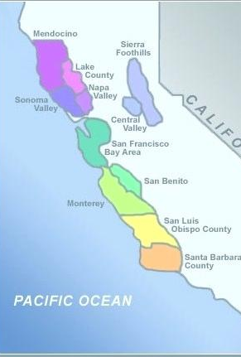
California Pinot Noir
The first two wines we will be tasting are from California.
Pinot Noir needs to be grown in cool climates. The Anderson Valley of Mendocino, north of Sonoma and Napa is just that.
One wine is from Mendocino and one is from Sonoma Valley.
In general, expect delicate aromas, balanced acidity, ripe cherry, plum and spice.

Slide 6
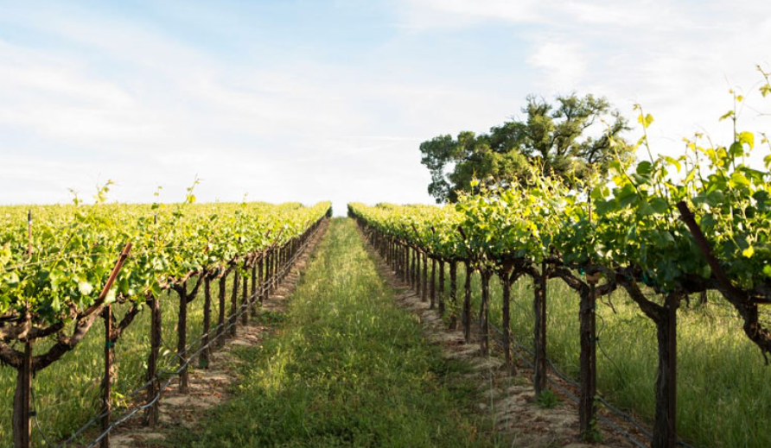
California Wines
California – 1: Coastal Estates 2017 $6.47
Vinted and bottled by Beaulieu Vineyard in Sonoma
More than 1,100 acres of estate vineyards and long-term relationships with grower partners
The largest producer of Cabernet Sauvignon in Napa Valley
California – 2: Angeline Reserve 2017 $17.49
90 pts per James Suckling
Certified California sustainable vineyard and winery
Our solar energy system supplies over 80% of the winery’s power.
All grape processing pomace (stems, seeds, skins) is recycled into vineyard and landscaping compost.
Angeline Winery

Slide 7
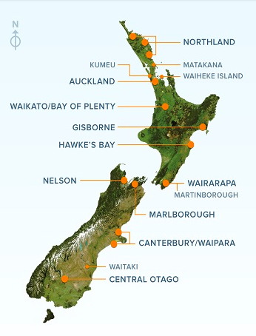
New Zealand Pinot Noir
The next two wines are from New Zealand.
Pinot Noir is predominantly grown in the cooler southernly regions. The huge diversity in climates and soils enables a wide range of styles from these main Pinot Noir producing regions.
Both wines we are tasting are from Marlborough.
In general, expect supple tannins, savory complexity, dark cherry, plum, currant and smoky oak notes.

Slide 8
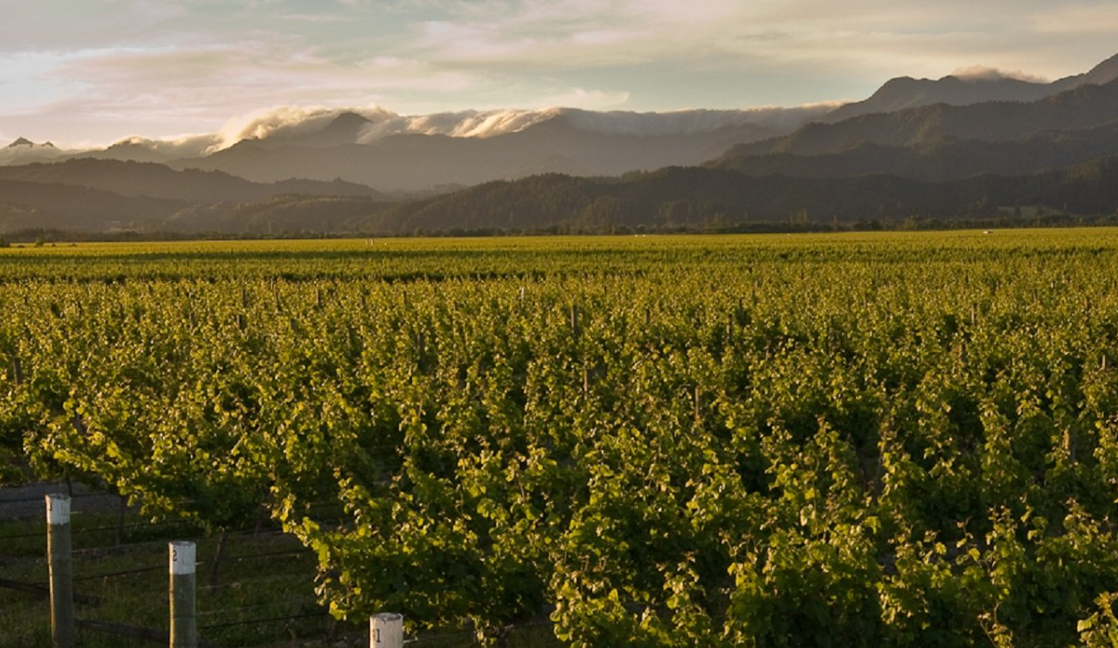
New Zealand
New Zealand – 3: Framingham 2013 $27.99
92 pts by James Suckling
Accredited as an environmentally sustainable vineyard, with individual small batched wines
Focus on the environment by avoiding systemic chemicals and planting flowers to encourage biodiversity.
Low rainfall and relatively low frost risk – they can harvest controlled yields at desired ripeness.
Harmless sediment may form in the bottle.
New Zealand – 4: Fire Road 2016 $14.99
Fruit for this wine was sourced from a selection of vineyard sites throughout Marlborough.
The wine was hand plunged frequently throughout fermentation.
Marlborough's worst ever fire on Boxing Day 2000, burnt almost 15,000 acres over the course of three days, and threatened the wine town of Blenheim, as well as a number of vineyards and wineries. Residents, of what is now known as Fireroad, battled the blaze by using buckets and hand held hoses and were eventually assisted by a fortunate wind shift. The Fireroad vineyards flourish in the same hot and dry climate that was the catalyst for such a mighty blaze.
Framingham Winery

Slide 9
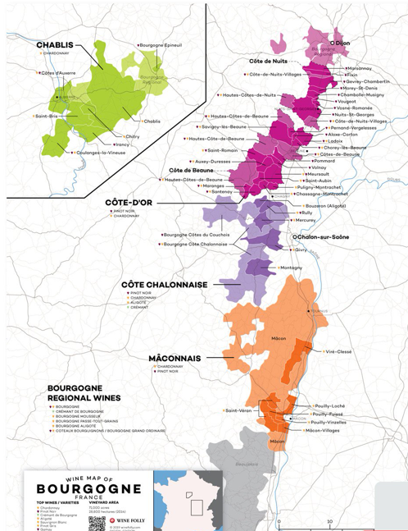
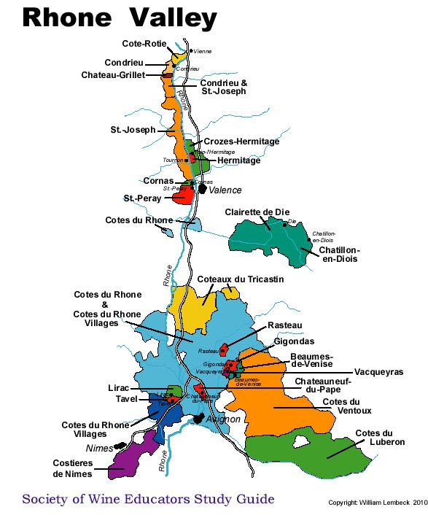
France Pinot Noir
One wine is a true Burgundy from Santenay, Burgundy, France
Burgundy is located in the east-central part of France. Burgundy has 5 primary wine growing areas.
The other wine is from the Rhone Valley.
In general, expect supple, jammy nuances, dark fruits and smooth tannins.

Slide 10
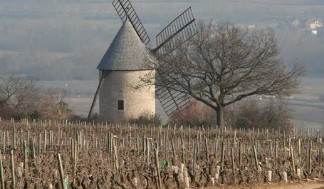
France
France– 5: D’Autrefois 2018 $12.99
Also comes in a “Reserve” which we didn’t choose because we felt this was more flavorful.
Conflicting reports as to where this wine was made. Some say the Burgundy Valley, and some say the Rhone Valley.
Considered an Indication Geographique Protegee (IGP) which is a classification of wine indicating a certain quality and authenticity; This classification was created to give winemakers a standard to promote their innovated and unorthodox wines outside of higher classifications.
France– 6: Belland Santenay Premier Cru - Beauregard 2017 $39.99
92 pts from Wine Enthusiast
Comes from a 57 acre family estate established in 1839
The estate is now run by Julie of the 6th generation
This winery is also eco friendly and sustainable.
Belland Winery

Slide 11
Do you really want to ask US questions???

